Slide 1
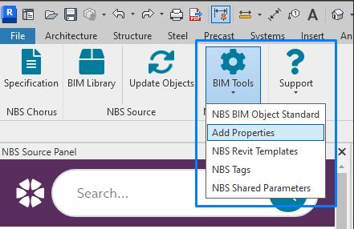
NBS Tool
Add Parameter Sets to the selected Revit Category
NBS
Uniclass
OmniClass
CoBie
IFC4 Facility management

Slide 2
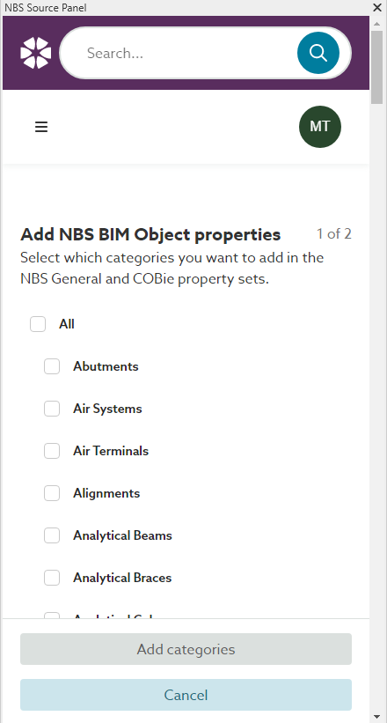
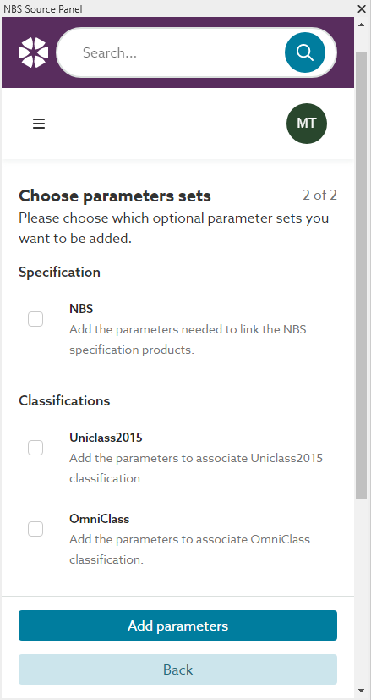
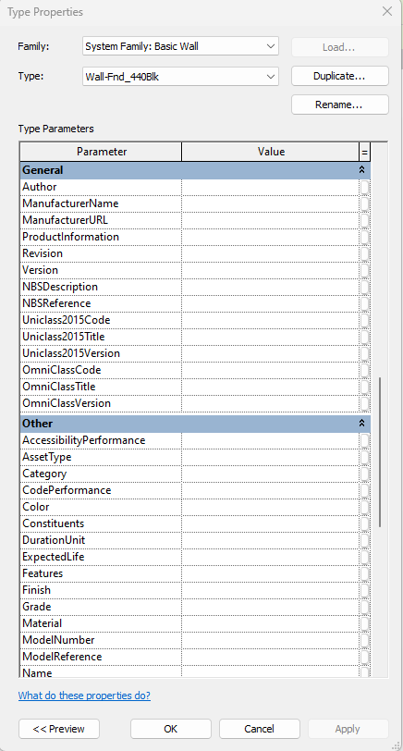
NBS Tool

Slide 3
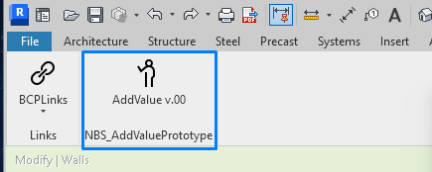
BCP Tool (concept)
Add Parameter Value to the following sets if applicable
NBS
Uniclass
OmniClass
CoBie
IFC4 Facility management

Slide 4
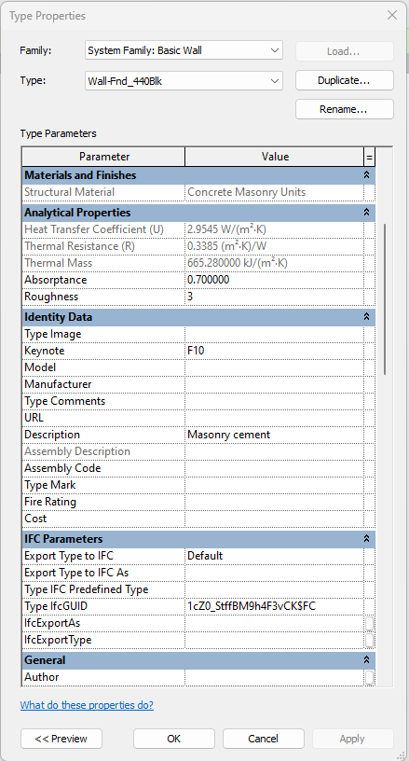
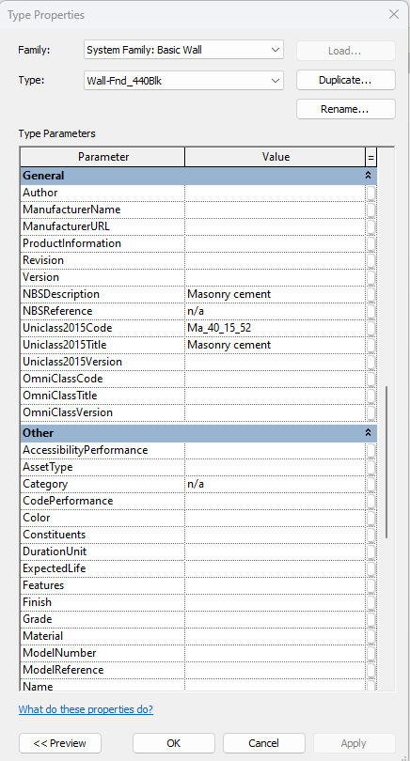
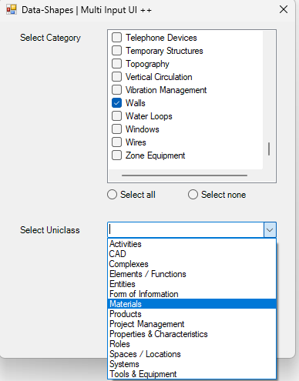
BCP Tool (concept)

